Slide 1
Computer Vision and Deep Learning
Lecture 12

Slide 2
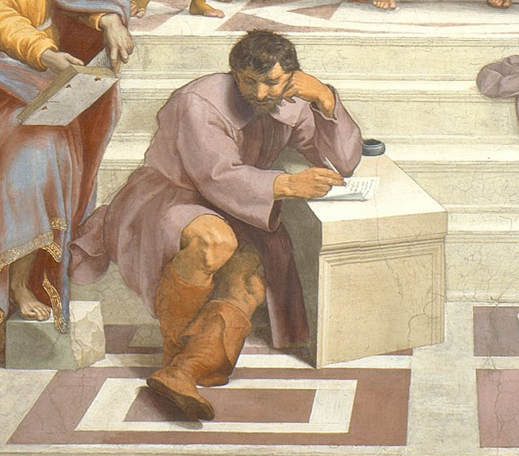
Understanding what networks learn
Much learning does not teach understanding. - Heraclitus

Slide 3
Today’s agenda
Visualization
Filters
Activations
Areas that trigger a neuron
Embeddings. t-SNE
DeepDream
Adversarial examples

Slide 4
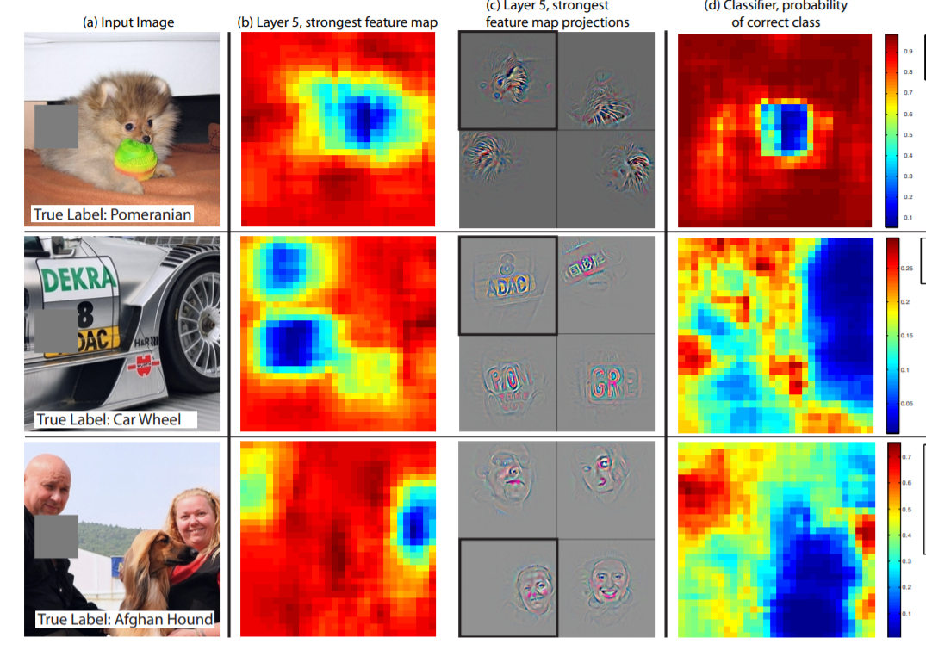
Saliency maps via image occlusions
Which are the important parts of an image?
Slide an occluding patch over the input image and display (as a heat map) the probability of the correct class

Slide 5
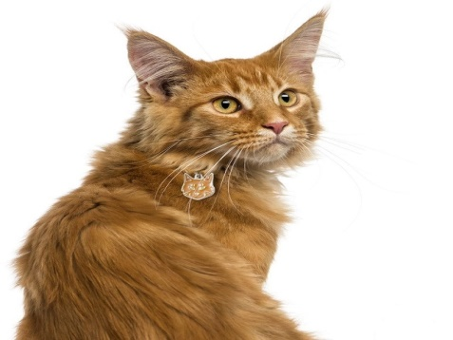

Saliency maps via image occlusions
P(cat) = 0.4
P(cat) = 0.96

Slide 6
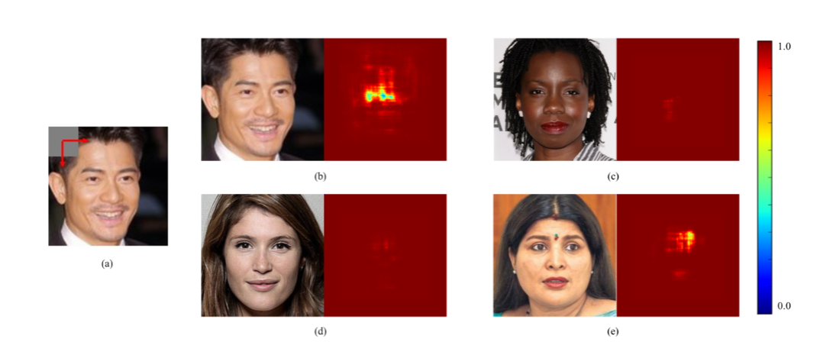
Saliency maps via image occlusions

Slide 7
Filter visualization – 1st layer
First layer operates directly on image pixels; visualize the filters used to extract the image features
Visualize this filter bank
https://machinelearningmastery.com/how-to-visualize-filters-and-feature-maps-in-convolutional-neural-networks/

Slide 8
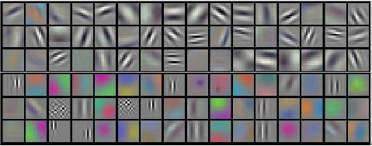
Filter visualization – 1st layer
First layer operates directly on image pixels; visualize the filters used to extract the image features

Slide 9
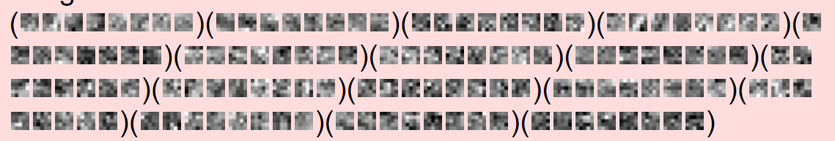

Filter visualization – deeper layers
Not that easy to interpret
https://cs.stanford.edu/people/karpathy/convnetjs/demo/mnist.html

Slide 10
Last layer visualization
The last layer (before the classification layer) contains the most condensed representation of the image

Slide 11
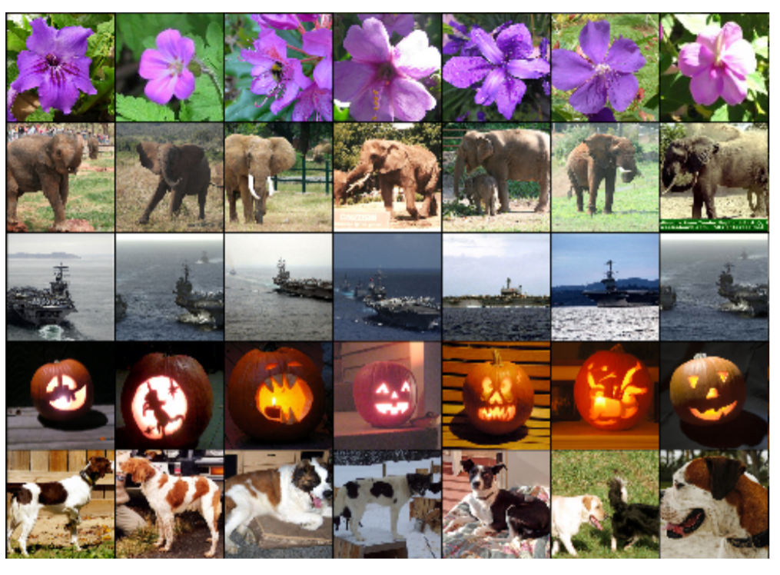
Last layer visualization Image embedding
Five ILSVRC-2010 test images in the first column. The remaining columns show the six training images that produce feature vectors in the last hidden layer with the smallest Euclidean distance from the feature vector for the test image

Slide 12
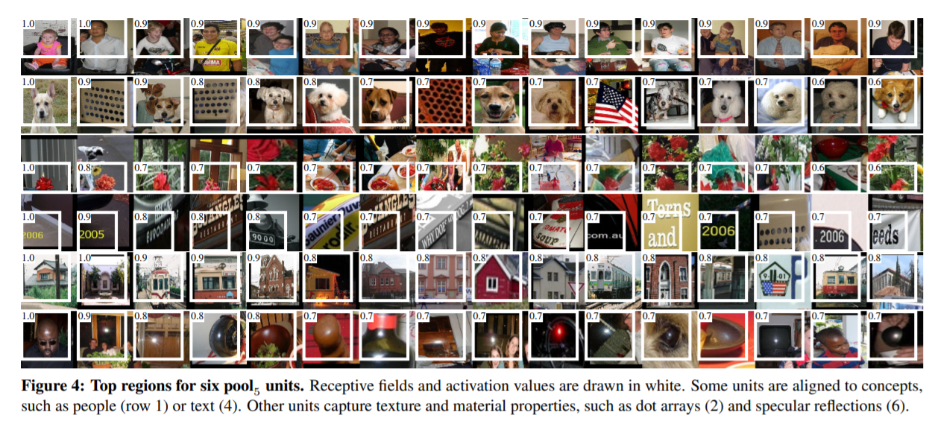
Visualize the patch that maximally activates a neuron
Single out a particular unit (feature) in the network and use it as if it were an object detector in its own right
compute the unit’s activations on a large set of held-out region, sort the proposals from highest to lowest activation, perform nonmaximum suppression, and then display the top-scoring region
https://arxiv.org/pdf/1311.2524.pdf

Slide 13
Activation maps
Deep visualization toolbox #deepvis
https://www.youtube.com/watch?v=AgkfIQ4IGaM

Slide 14
Activation maps
Compute the gradient of a given neuron in the network with respect to the input image
Select the layer, set the gradient at that level to be all zeros except for the neuron of interest (where we set the gradient at 1)
Apply backpropagation to the image
https://arxiv.org/pdf/1412.6806.pdf

Slide 15
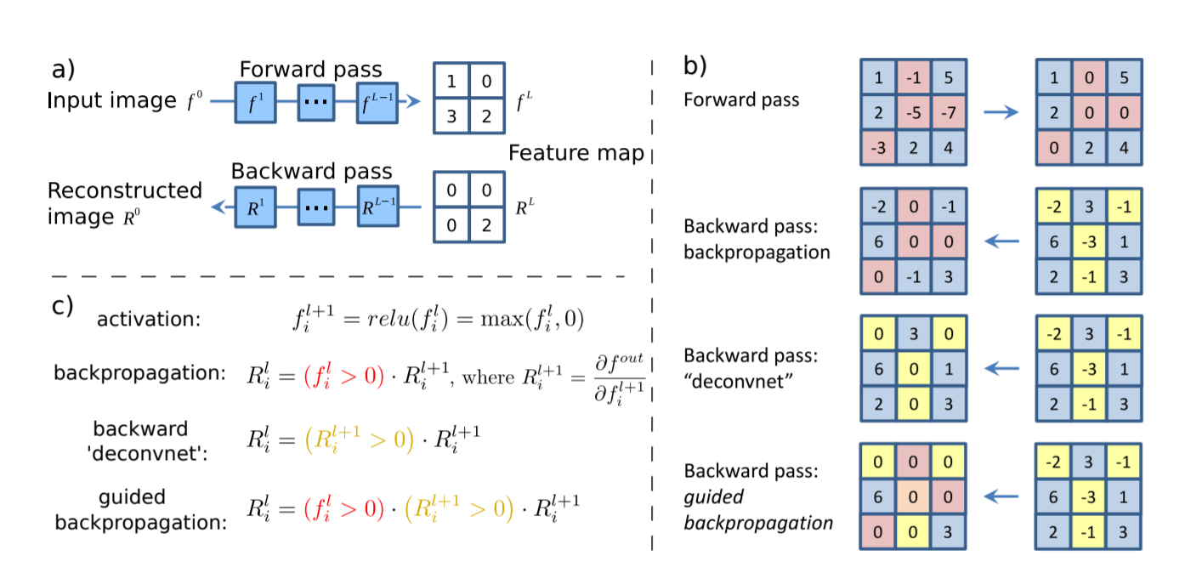
Activation maps
Zero out all the gradients except for the neuron of interest
https://arxiv.org/pdf/1412.6806.pdf

Slide 16
Activation maps
RELU during backward pass: block the gradients for the neurons that had activations < 0
RELU
https://arxiv.org/pdf/1412.6806.pdf

Slide 17
Activation maps
Guided back-propagation: backprop only the parts that have a positive gradient
Paths of influence
Pass only gradients that have a positive influence. Keep only the positive influence
https://arxiv.org/pdf/1412.6806.pdf

Slide 18
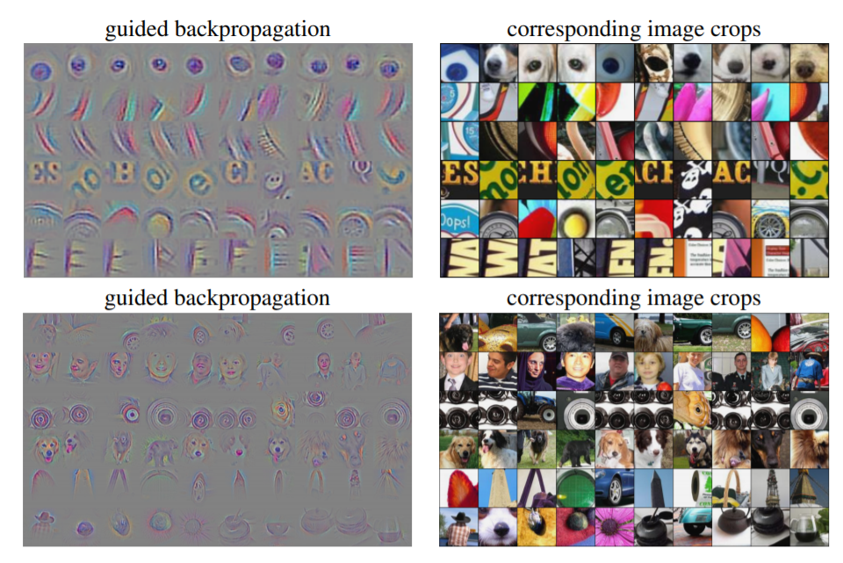
Activation maps
Visualization of patterns learned by the layer conv6 (top) and layer conv9 (bottom) of the network trained on ImageNet.

Slide 19
Saliency maps – visualize the data gradient Important image pixels
Heat map of the gradients
Compute gradient of the (un-normalized) class score with respect to image pixels and then take absolute value and max over RGB channels
Strength of influence of each pixel on the class score
https://arxiv.org/pdf/1312.6034.pdf

Slide 20
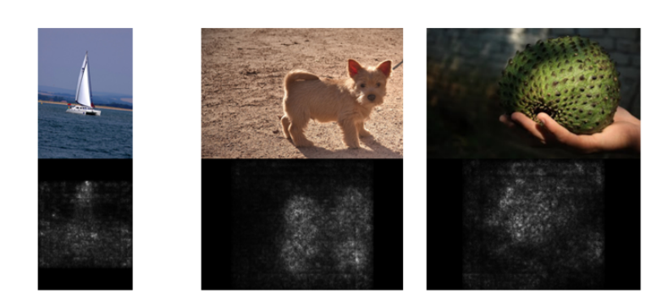
Saliency maps – visualize the data gradient Important image pixels
https://arxiv.org/pdf/1312.6034.pdf

Slide 21
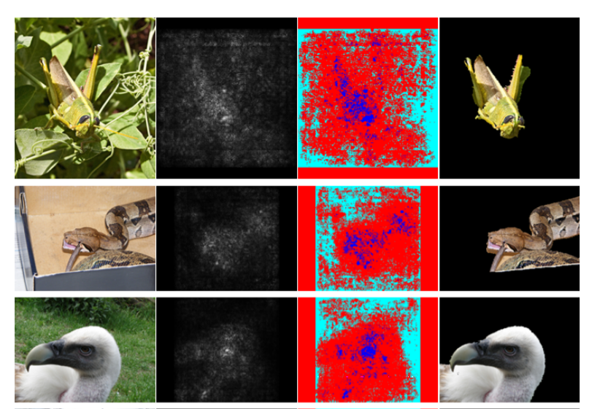
Guided image segmentation
https://arxiv.org/pdf/1312.6034.pdf

Slide 22
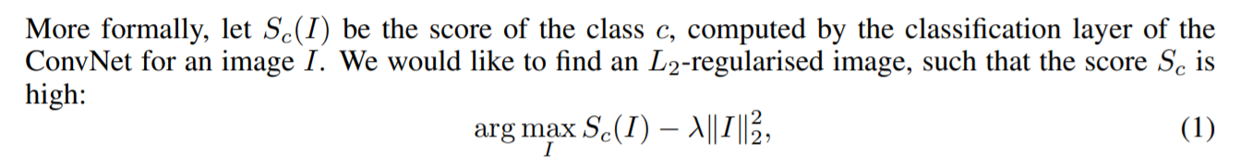
Optimize the image
Keep the parameters of the network fixed and optimize the input image for some class score
Zero image
Forward pass
Set the gradient of the scores vector to be all zeros except for the class of interest and then back-prop to the image
[0, 0, …., 0, 1, …, 0]
Image update
Forward image to the networks
repeat

Slide 23
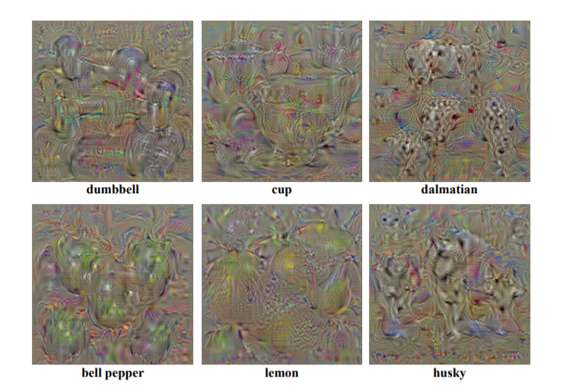
Optimize the image
https://arxiv.org/pdf/1312.6034.pdf

Slide 24
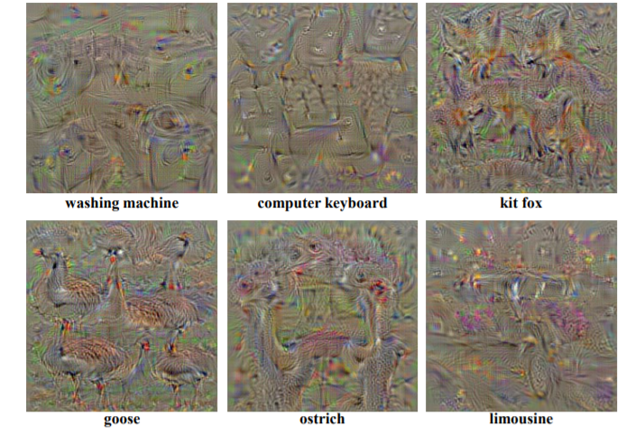
Optimize the image
https://arxiv.org/pdf/1312.6034.pdf

Slide 25
Deep dream
“Dream” at a given layer of the network (after the ReLu units)
Forward pass to the give image
Set the gradients to be equal to the activation
Backprop to the image
Modify the image such that it amplifies the activations at any given layer
https://github.com/google/deepdream/blob/master/dream.ipynb

Slide 26
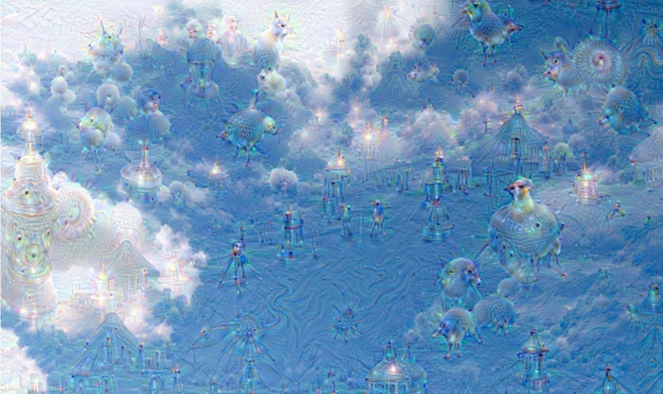
Deep dream
Whatever was activates gets boosted

Slide 27
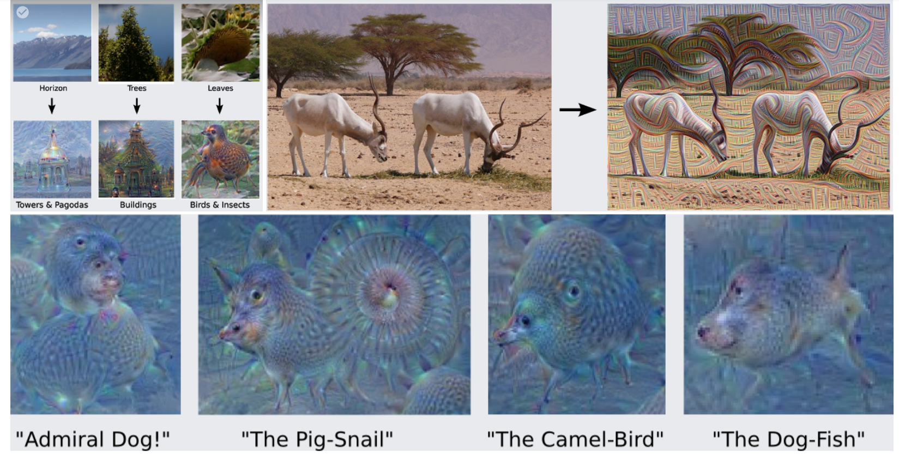
Deep dream

Slide 28
Adversarial examples

Slide 29
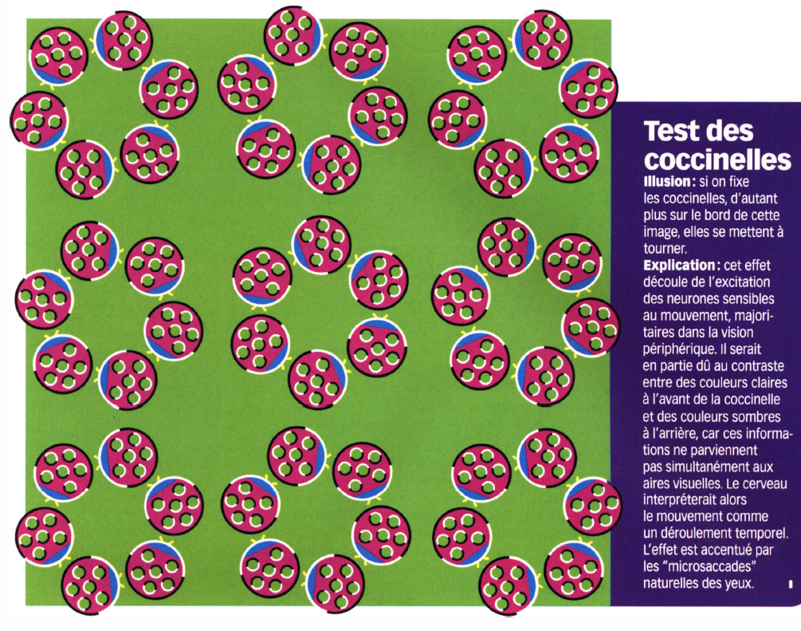
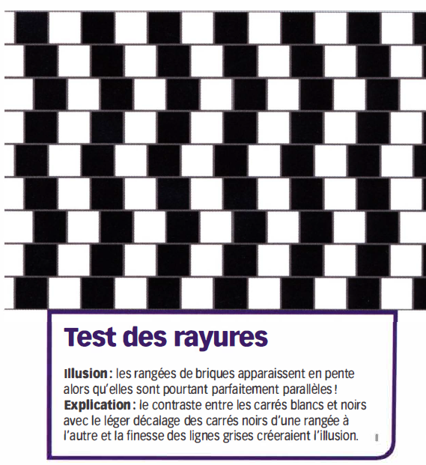

Slide 30
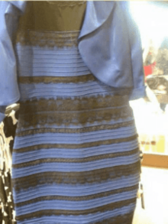
“Adversarial” examples for the human brain #thedress
#whiteandgold
#blackandblue

Slide 31
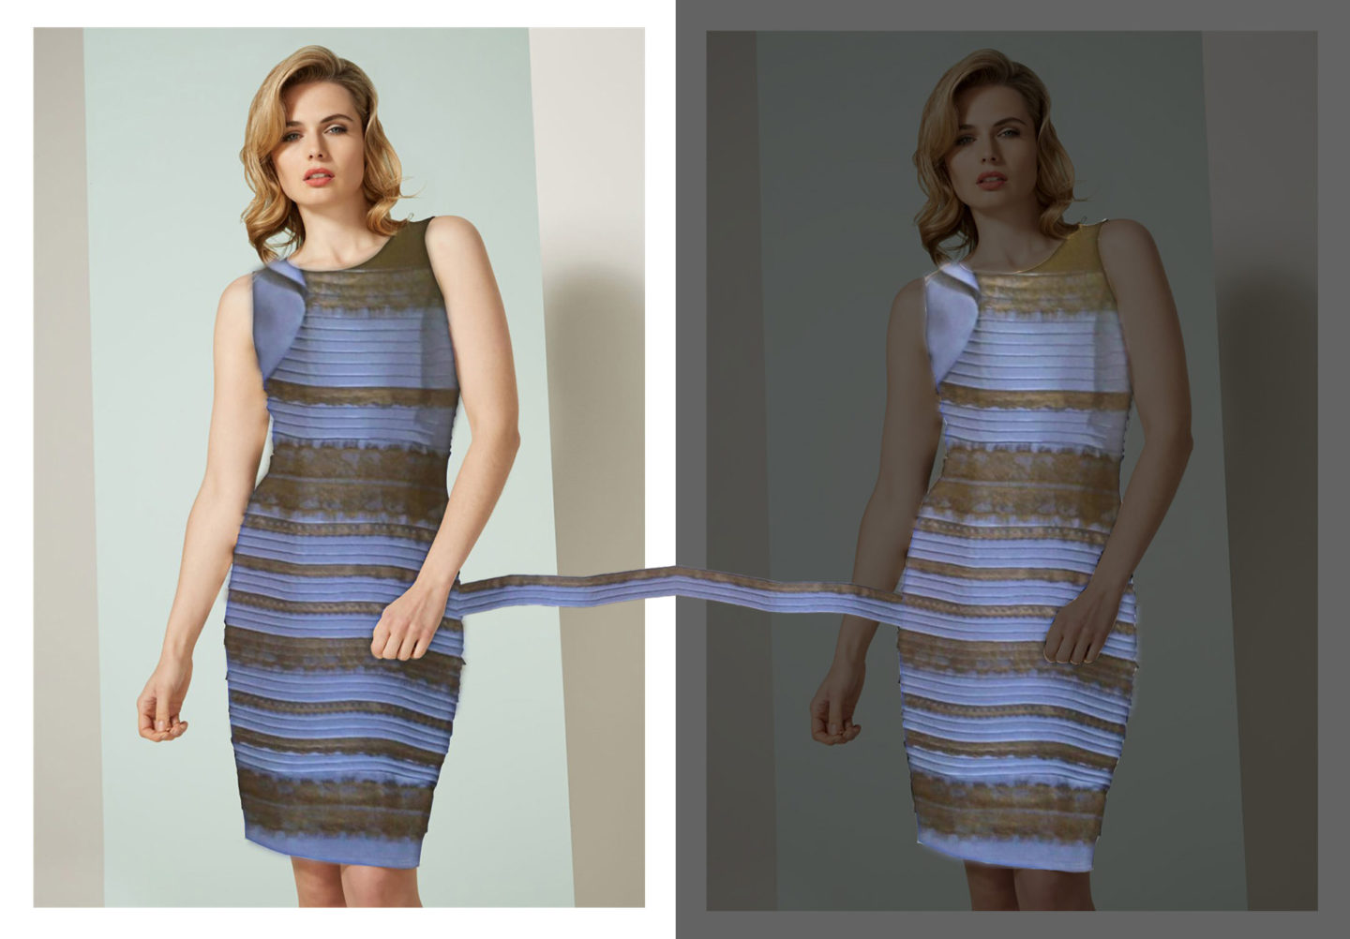

Slide 32
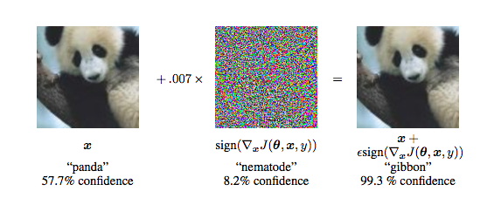
Adversarial examples
An adversarial example is an instance with small, intentional feature perturbations that cause a machine learning model (!not only CNNs!) to make a false prediction.

Slide 33
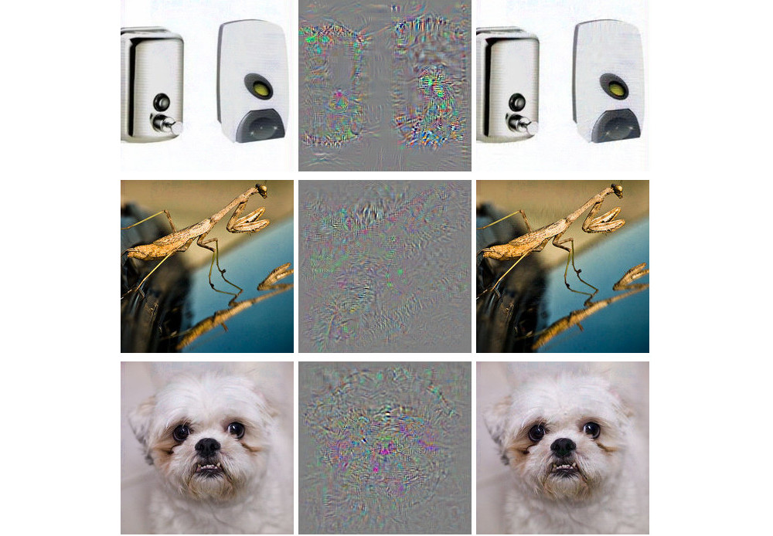
Make everything an ostrich
Szegedy, Christian, et al. "Intriguing properties of neural networks." arXiv preprint arXiv:1312.6199 (2013).

Slide 34
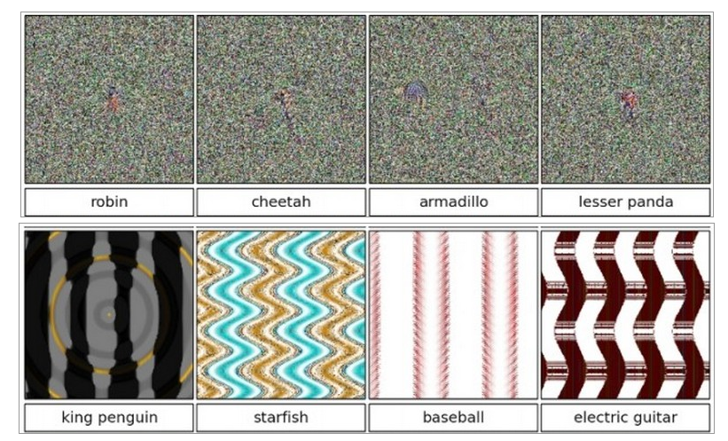
Classifying noise
Nguyen, Anh, Jason Yosinski, and Jeff Clune. "Deep neural networks are easily fooled: High confidence predictions for unrecognizable images." Proceedings of the IEEE conference on computer vision and pattern recognition. 2015.

Slide 35
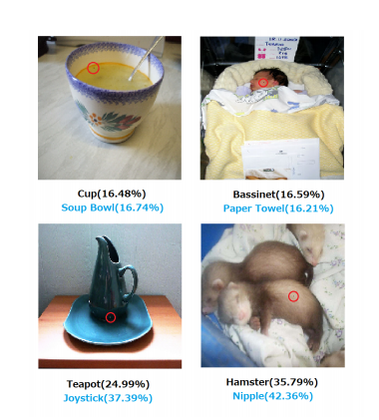
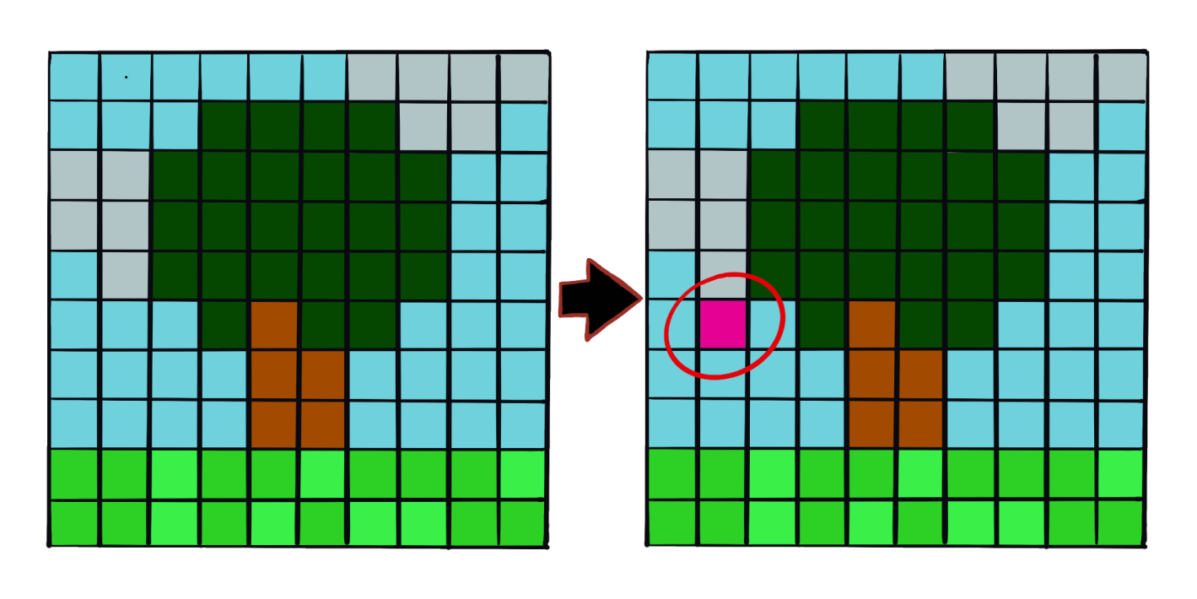
1-pixel attacks
Constraint: when designing the adversarial example only one pixel may change
One Pixel Attack for Fooling Deep Neural Networks, Su et al. , 2019

Slide 36
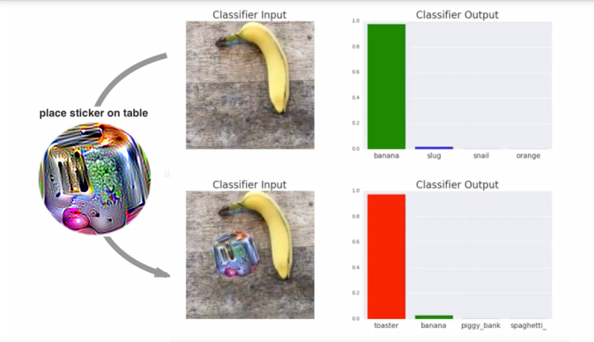
Adversarial patch Make everything a toaster

Slide 37
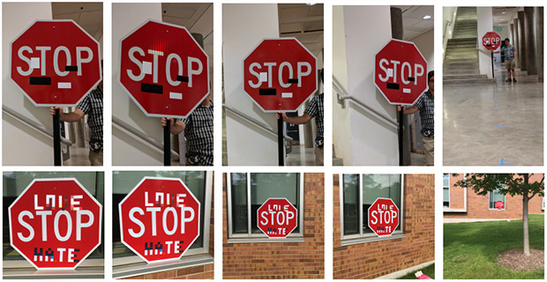
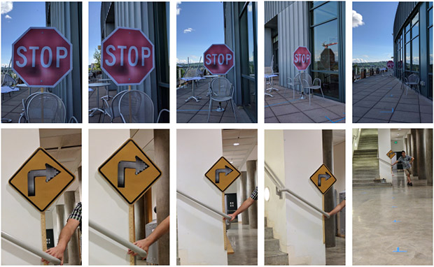
Slight alterations in the physical world
https://spectrum.ieee.org/cars-that-think/transportation/sensors/slight-street-sign-modifications-can-fool-machine-learning-algorithms

Slide 38
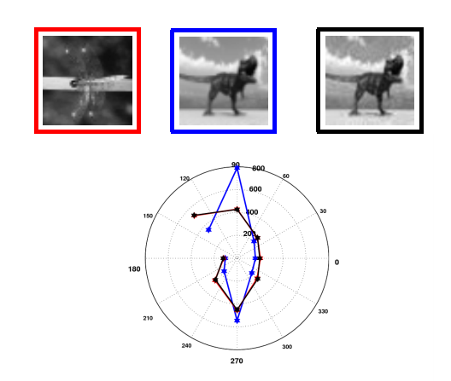
Adversarial examples occur not only for CNNs but also for handcrafted features
HOG descriptor
Exploring the Representation Capabilities of the HOG Descriptor, Tatu et. al

